Slide 1
Goal Directed Knowledge Acquisition
Christopher Weber, Daniel Morwood, and Daniel Bryce

Slide 2
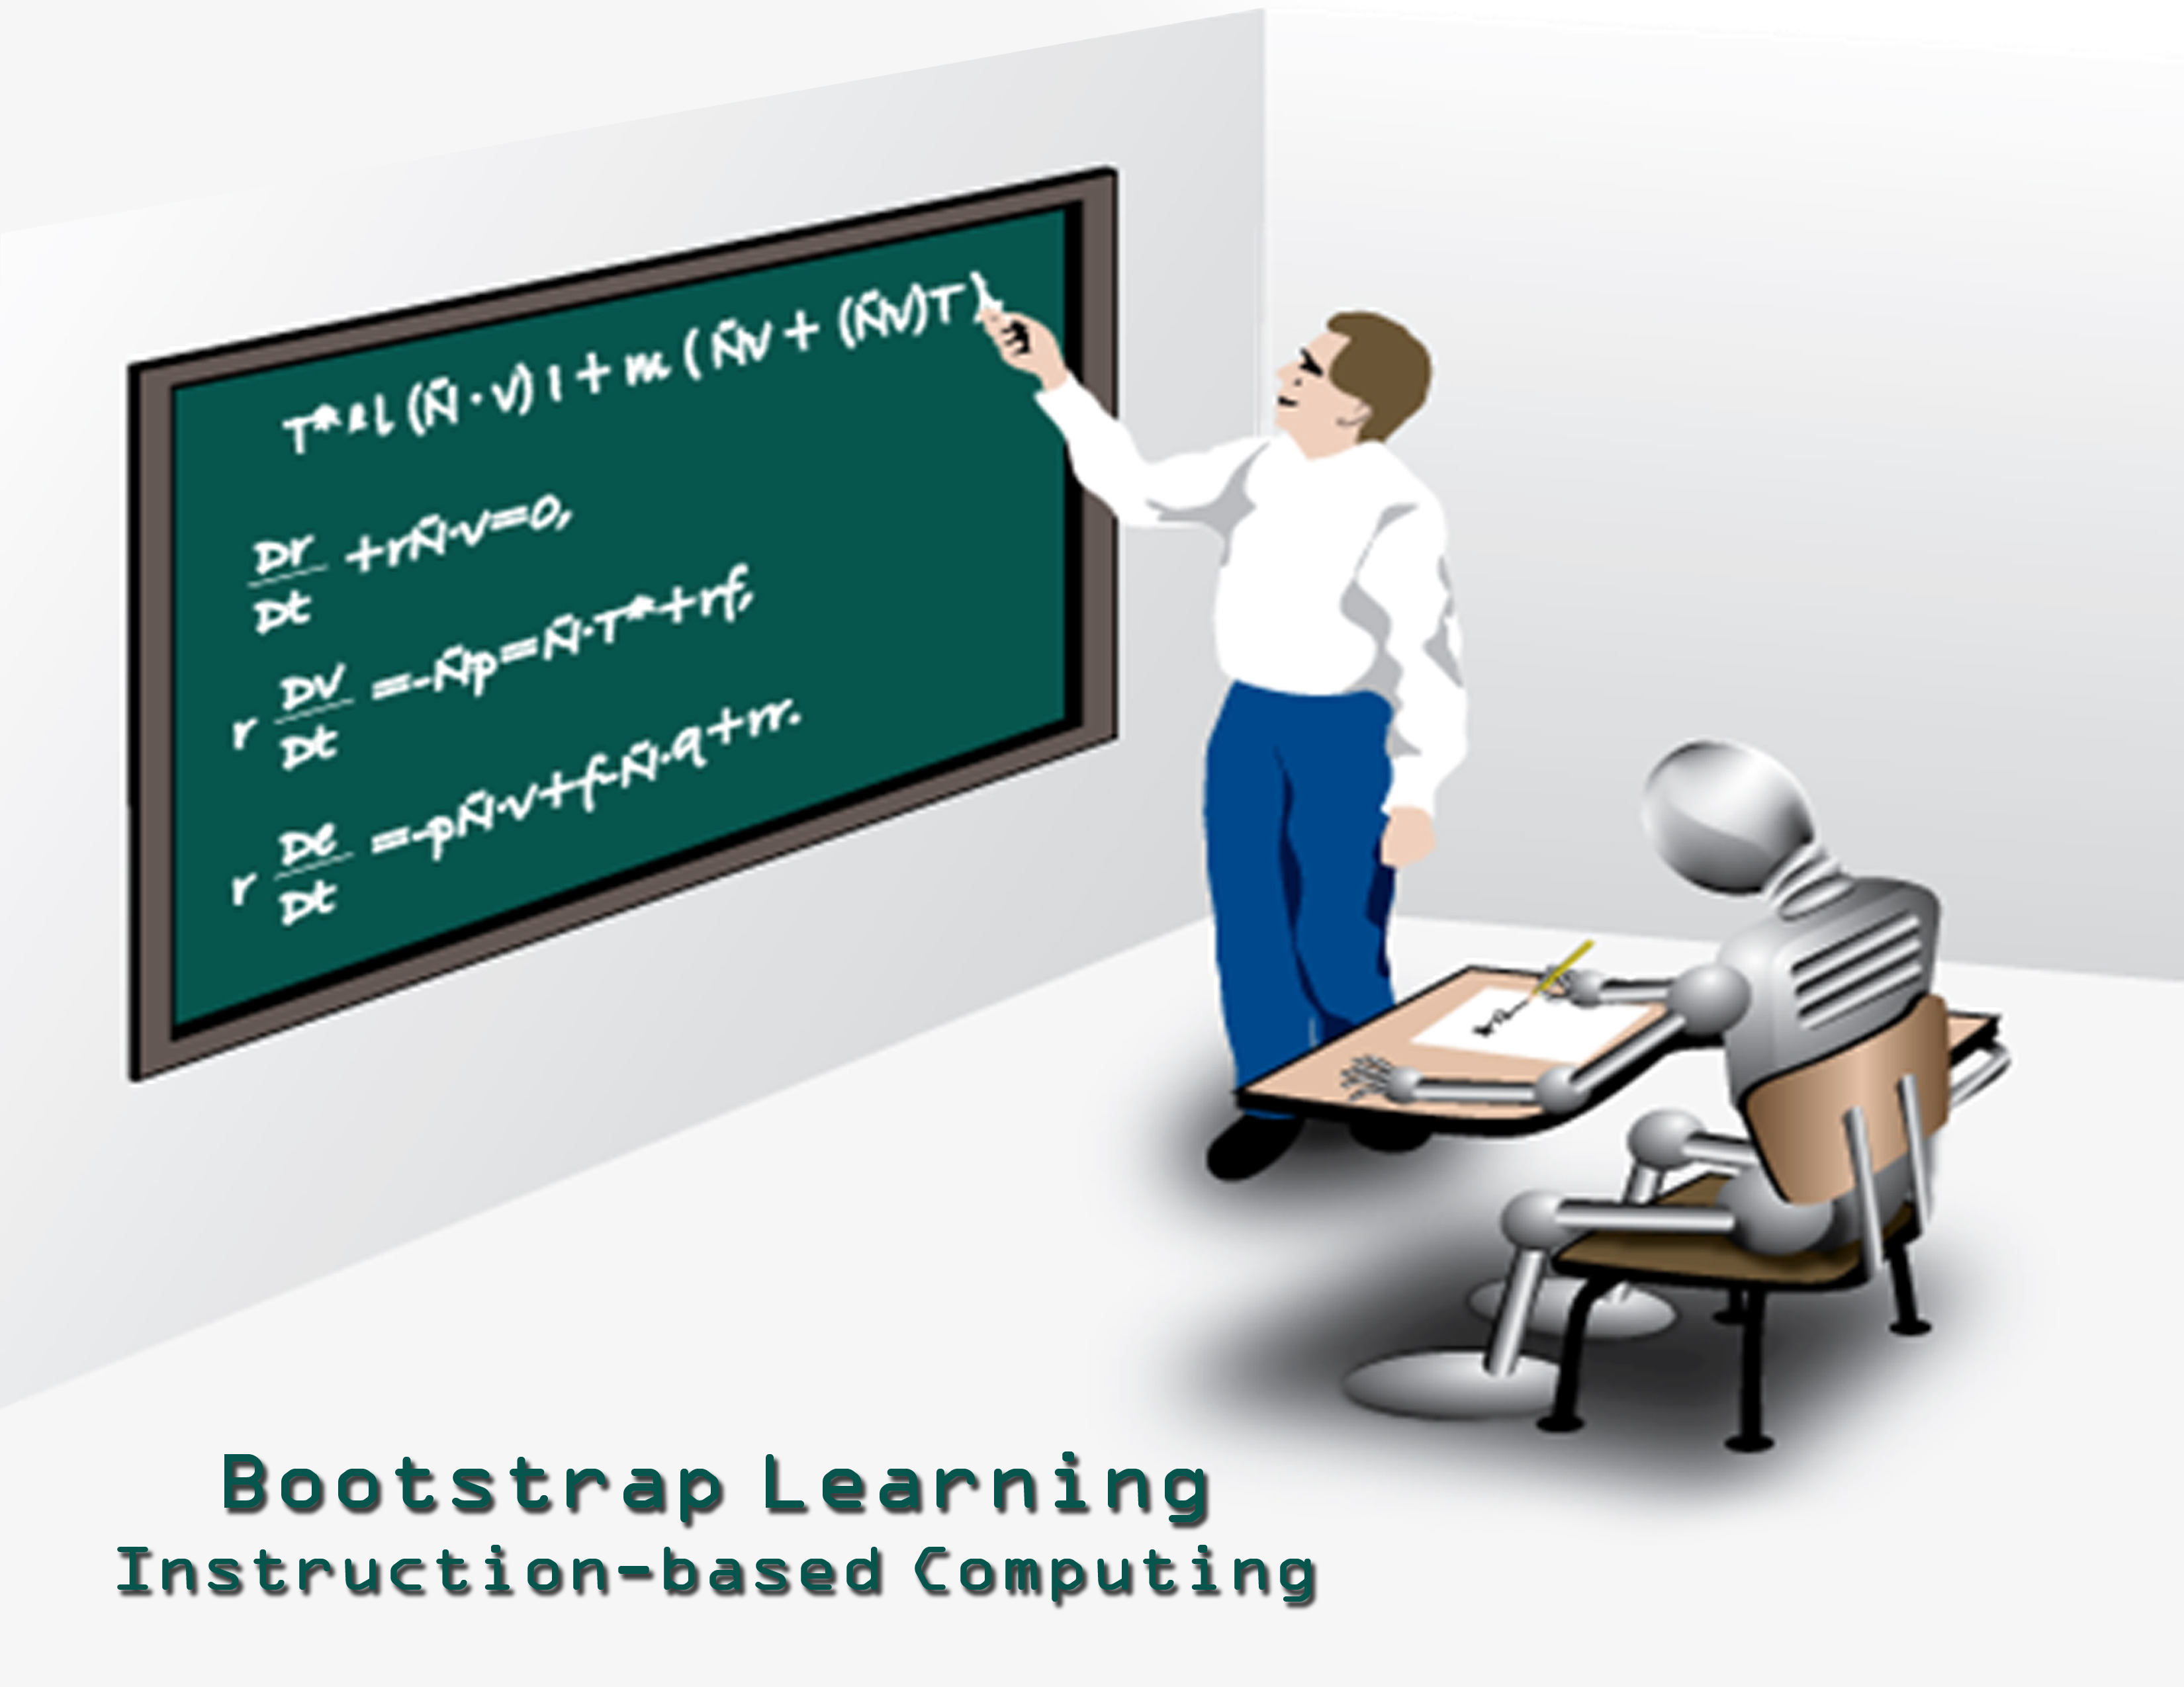
Approach
Acquire Relevant Domain Knowledge
Plan under Uncertainty [Weber and Bryce, ICAPS11]
Diagnose Possible Failures[Weber and Bryce, ICAPS11]
Elicit (Probe) Domain Knowledge
Re-Plan
Notes:
----- Meeting Notes (6/13/11 07:22) -----
Asking questions is costly too

Slide 3
Incomplete Domain Knowledge
STRIPS: (P,A,I,G)
P: Set of propositions
A: Incomplete Actions
Known: Preconditions, Adds, Deletes
Possible: Preconditions, Adds, Deletes
Impossible: Preconditions, Adds, Deletes
I: Initial State
G: Goal

Slide 4
PARC Printer
(:action HtmOverBlack-Move-A4
:parameters ( ?sheet - sheet_t )
:precondition (and (clear) (Available HtmOverBlack-RSRC)
(Sheetsize ?sheet A4)
(Location ?sheet HtmOverBlack_Entry-EndCap_Exit))
:effect (and (not (Available HtmOverBlack-RSRC))
(Location ?sheet HtmOverBlack_Exit-Down_TopEntry)
(not (Location ?sheet HtmOverBlack_Entry-EndCap_Exit))
(Available HtmOverBlack-RSRC))
:poss-effect (and (not (clear))))

Slide 5
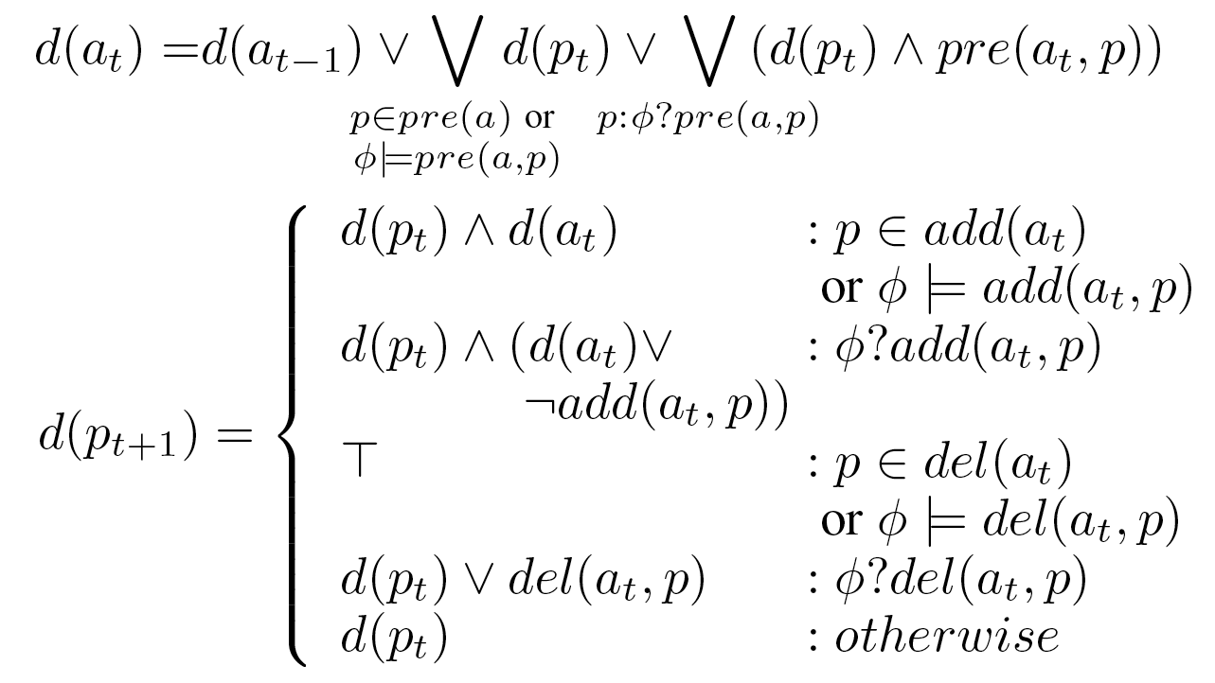
Plan Failure Explanation

Slide 6
Plan Failure Explanations
Propositions = {p,q,r,g}
Incomplete Actions = {a,b,c}
Initial State = {p, q}
Goal = {g}
Incomplete Features = {pre(a, r), add(a, r), del(a, p), del(b, q), pre(c, q)}
Complete Features: pre(a) = {p, q};
pre(b) = {r}, add(b) = {r};
pre(c) = {r}, add(c) = {g}.
State Sequence: (s0 = {p,q}, s1 = {p,q,r}, s2 = {q,r}, s3 = {q,r,g})
Notes:
----- Meeting Notes (6/13/11 07:22) -----
change figure

Slide 7
Knowledge Elicitation Strategies
Naïve Extremes
Learn by action (no elicitation)
Learn by Exhaustion (elicit everything)
Goal-Directed
Plan Relevant (all actions in plan)
Diagnosis Relevant
Rank By Diagnosis Impact
Rank By Shannon Entropy
May require re-planning
Use relaxation instead

Slide 8
Passive Learning
Notes:
----- Meeting Notes (6/13/11 07:22) -----
Need to lead in to types of learning

Slide 9
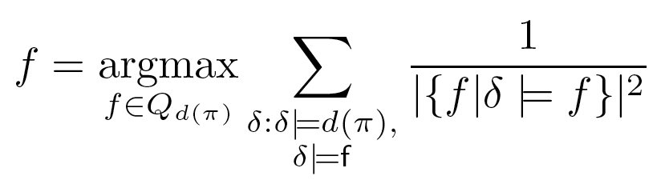
Proactive Learning
1/1²=1
1/1²=1
1/2²=0.25
1/2²=0.25
Notes:
----- Meeting Notes (6/13/11 07:22) -----
Need formula for DI

Slide 10
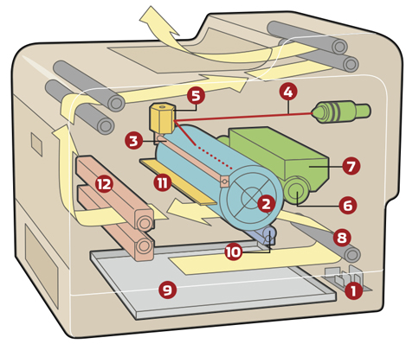


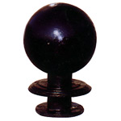




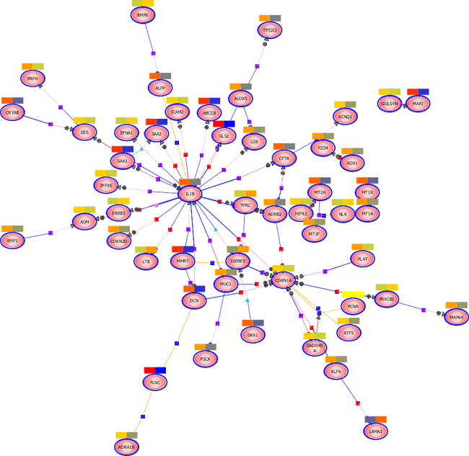
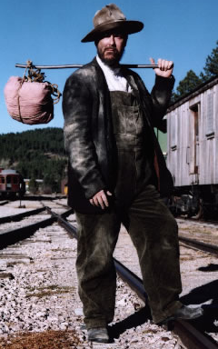
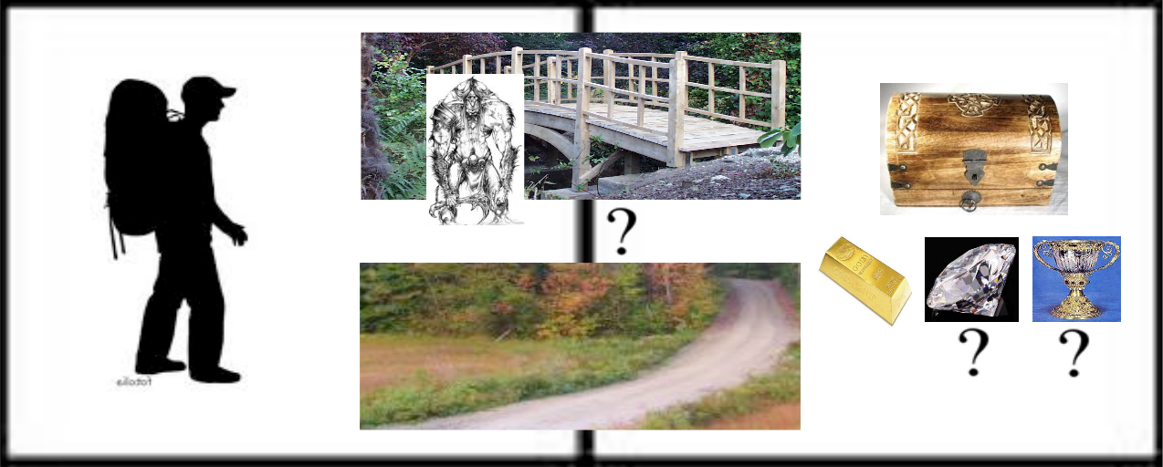
Domains

Slide 11
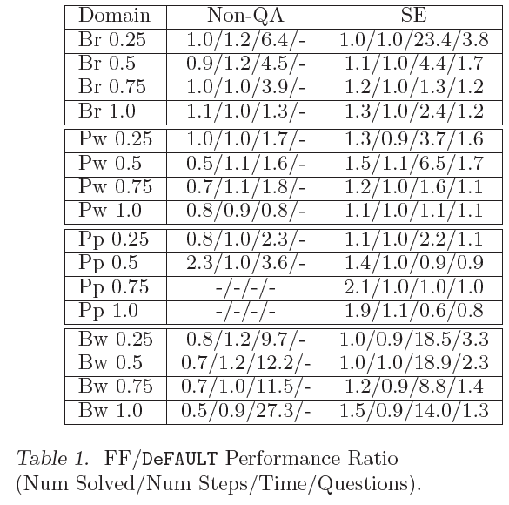
Results
Classical Planner
takes more time and actions,
and asks more questions asking questions or not,
But solves more instances in most cases

Slide 12
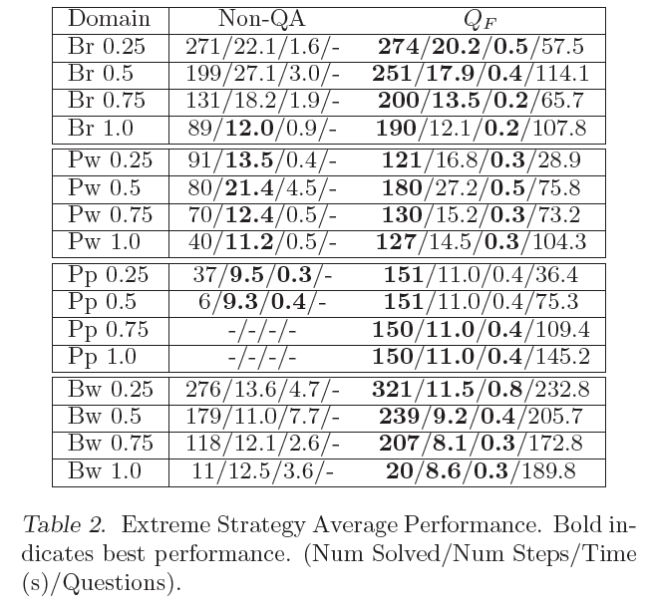
Results
Eliciting all knowledge increases solved instances, reduces time, but requires many questions on average.
Notes:
Default increases success but scales worse
Passive fails a lot
Proactive asks lots of

Slide 13
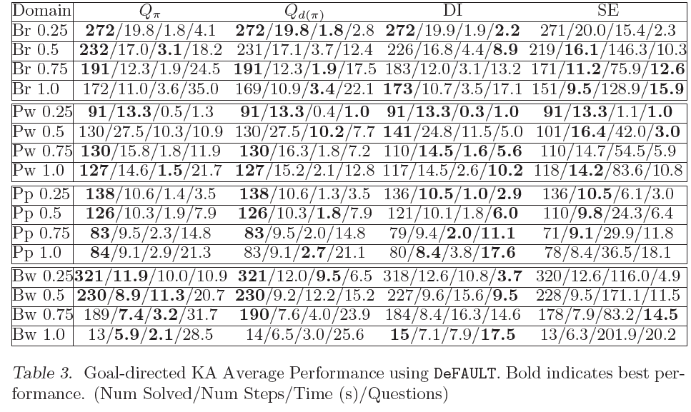
Results
Prioritizing Plan Diagnoses reduces questions the most,
but computing Shannon Entropy is costly in terms of time

Slide 14
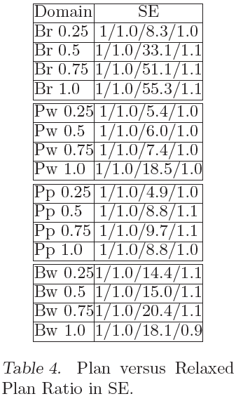
Results
Computing Relaxed Plan Diagnoses does not increase questions and makes time competitive

Slide 15
Summary
Plan Diagnoses enable Goal-Directed Knowledge Acquisition
Planners that reason about incompleteness generate better diagnoses
Ranking questions by diagnoses reduces questions
Relaxed plans generate good diagnoses too

Slide 16
Thanks
Source Code and generators available on web!
http://www.cs.usu.edu/~danbryce/software/default.jar

